Slide 1
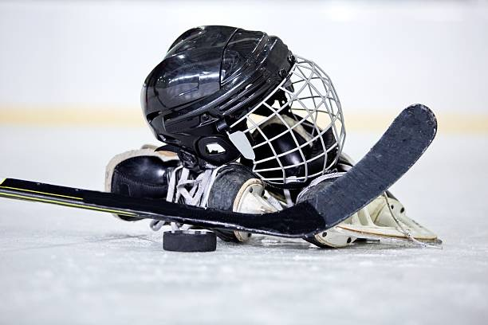
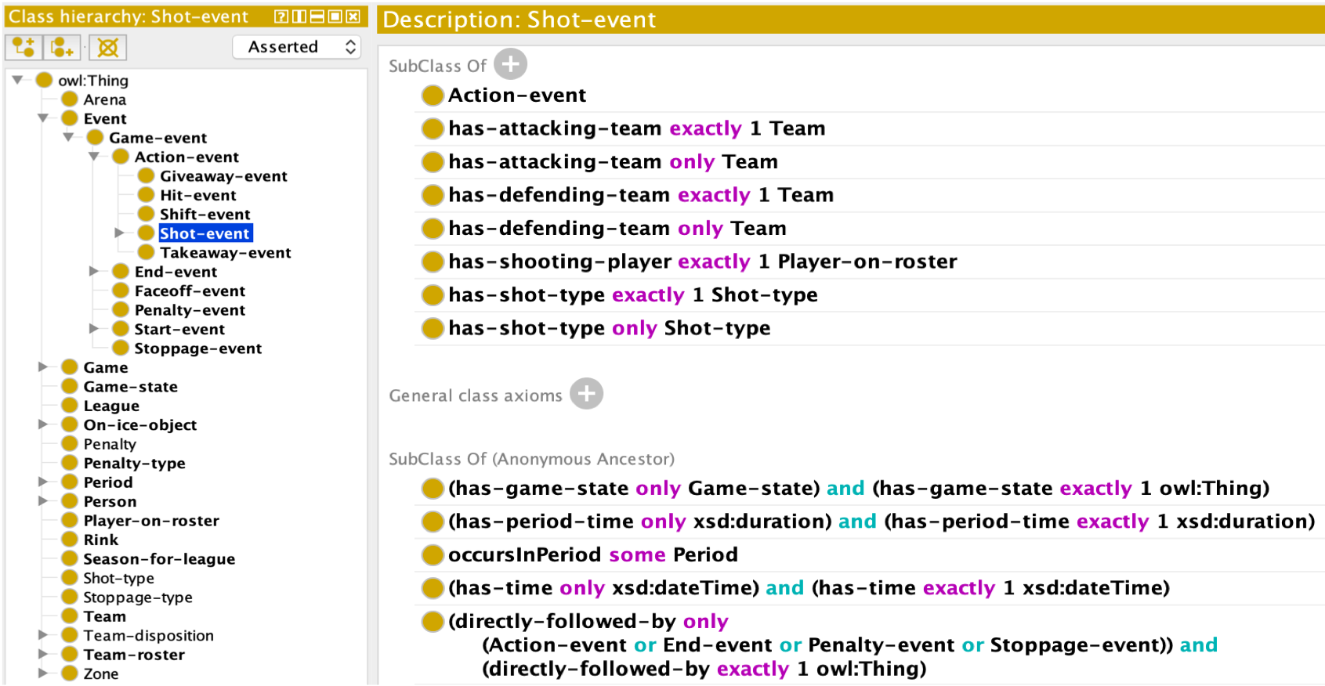
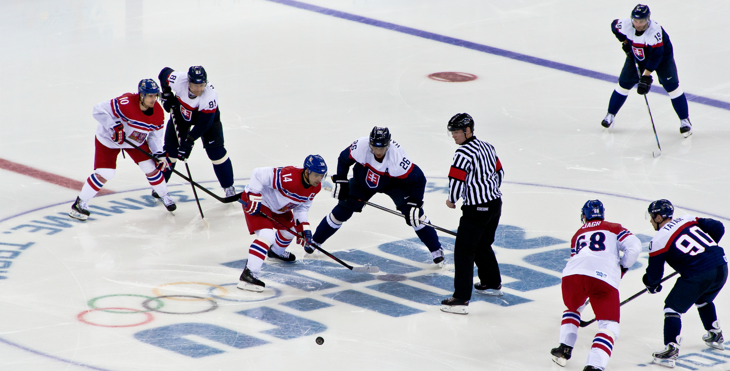

An Ontology For Ice Hockey
Robin Keskisärkkä, Huanyu Li, Sijin Cheng,
Niklas Carlsson and Patrick Lambrix
Linköping University, Linköping, Sweden
Motivation
A
B
c
Current Coverage
a
Ontology design and development
A
b
C
Conclusion
A
B
C

